Slide 1
Module 4
Lecture 3:
Uncertainty,
Probabilistic Reasoning
Bayes Theorem & Conditional Probability

Slide 2

With this knowledge representation, we might write A→B, which means if A is true then B is true, but consider a situation where we are not sure about whether A is true or not then we cannot express this statement, this situation is called uncertainty.
What is Uncertainty ?

Slide 3
Causes of uncertainty:
Information occurred from unreliable sources.
Experimental Errors
Equipment fault
Temperature variation
Climate change.

Slide 4

Probabilistic reasoning

Slide 5
Need of probabilistic reasoning in AI
When there are unpredictable outcomes.
When specifications or possibilities of predicates becomes too large to handle.
When an unknown error occurs during an experiment.

Slide 6
In probabilistic reasoning, there are two ways to solve problems with uncertain knowledge:
Bayes' rule
Bayesian Statistics

Slide 7

Probability:
0 ≤ P(A) ≤ 1, where P(A) is the probability of an event A.
P(A) = 0, indicates total uncertainty in an event A.
P(A) =1, indicates total certainty in an event A.

Slide 8

Conditional probability:
Let's suppose, we want to calculate the event A when event B has already occurred, "the probability of A under the conditions of B", it can be written as:

Slide 9

Where P(A⋀B) = Joint probability of A and B. P(B) = Marginal probability of B. If the probability of A is given and we need to find the probability of B, then it will be given as:

Slide 10
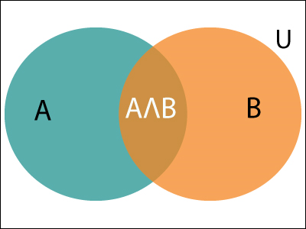

Slide 11

Example: In a class, there are 70% of the students who like English and 40% of the students who likes English and mathematics, and then what is the percent of students those who like English also like mathematics? Solution: Let, A is an event that a student likes Mathematics B is an event that a student likes English.

Slide 12
Bayes' theorem:
Bayes' theorem is also known as Bayes' rule, Bayes' law, or Bayesian reasoning, which determines the probability of an event with uncertain knowledge.
In probability theory, it relates the conditional probability and marginal probabilities of two random events.
It is a way to calculate the value of P(B|A) with the knowledge of P(A|B).
Bayes' theorem allows updating the probability prediction of an event by observing new information of the real world.

Slide 13
Bayes' theorem can be derived using product rule and conditional probability of event A with known event B: As from product rule we can write: P(A ⋀ B)= P(A|B) P(B) Similarly, the probability of event B with known event A: P(A ⋀ B)= P(B|A) P(A)

Slide 14

P(A|B) is known as posterior, which we need to calculate, and it will be read as Probability of hypothesis A when we have occurred an evidence B.
P(B|A) is called the likelihood, in which we consider that hypothesis is true, then we calculate the probability of evidence.
P(A) is called the prior probability, probability of hypothesis before considering the evidence.
P(B) is called marginal probability, pure probability of an evidence.

Slide 15

In the equation (a), in general, we can write P (B) = P(A)*P(B|Ai), hence the Bayes' rule can be written as:
Where A₁, A₂, A₃,........, A_{n} is a set of mutually exclusive and exhaustive events.

Slide 16

Applying Bayes' rule:
Example:
Question: From a standard deck of playing cards, a single card is drawn. The probability that the card is king is 4/52, then calculate posterior probability P(King|Face), which means the drawn face card is a king card.

Slide 17


Solution:
P(king): probability that the card is King= 4/52= 1/13.
P(face): probability that a card is a face card= 3/13.
P(Face|King): probability of face card when we assume it is a king = 1
Putting all values in equation (i) we will get:

Slide 18
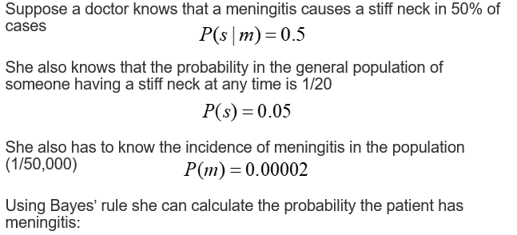
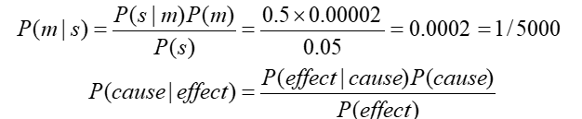

Slide 19
Application of Bayes' theorem in Artificial intelligence:
It is used to calculate the next step of the robot when the already executed step is given.
Baye’s theorem is helpful in weather forecasting.
It can solve the Monty Hall problem.

